Slide 1
Crime data from 2010 to 2019 in the city of Los Angeles
DS5610 Exploratory Data Analysis
Stella Wu
November 7th 2023

Slide 2
Introduction/Motivation
Safety is a big part of people’s daily life. And crime rate is a big factor that’s affecting safety.
Having the data set, I wonder… 1) Is the crime rate increasing or decreasing overtime? 2) What time throughout the day is the most dangerous? 3) Is there any specific locations that are more dangerous than the others?
Good for: 1) Citizens: Enhanced Safety, Preventive Measures, Community Awareness… 2) LAPD: Resource Allocation, Predictive Enforcement, Public Safety and Policy Making…
Notes:
Safety is a big part of ppl’s daily life. And crime rate is a big factor that’s affecting safety. Having all those terrible news of crimes happened made me kinda wanna dive into this crime data and see …

Slide 3
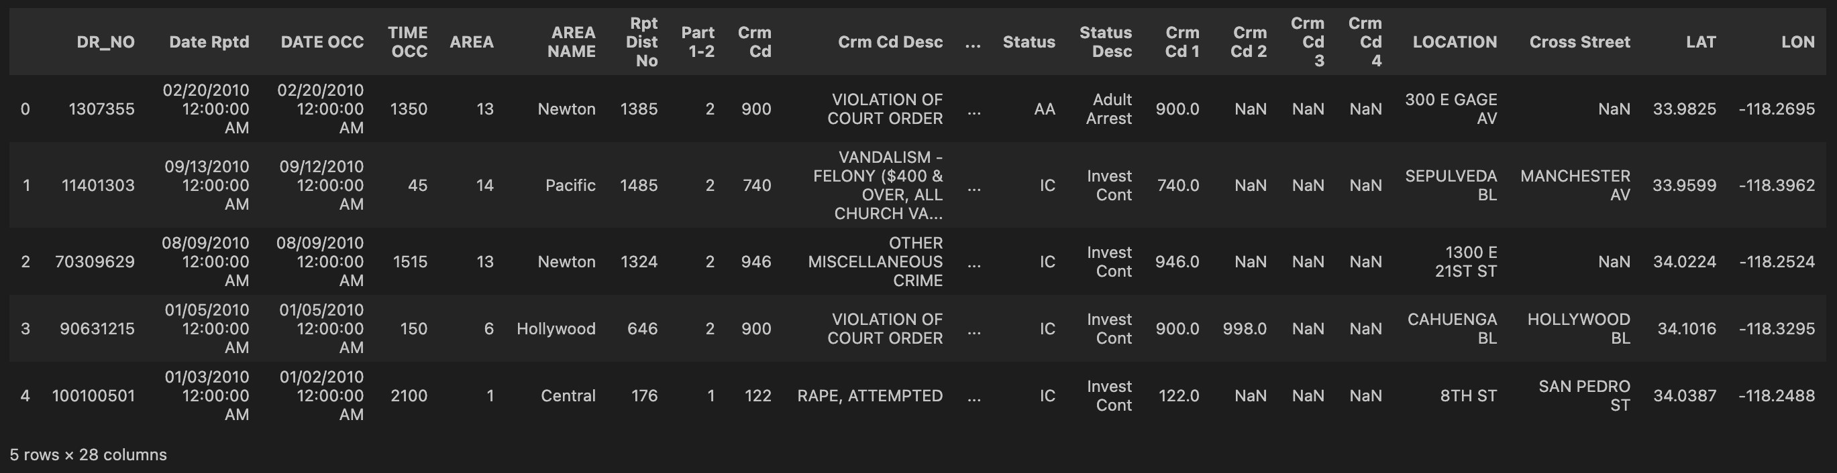
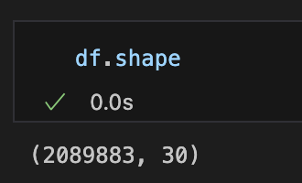
Data
Origin: LAPD OpenData (https://catalog.data.gov/dataset/crime-data-from-2010-to-2019)
Data information:
Data cleaning:
1) Add three columns that indicates ‘Year’, ‘Month’ and ‘Time’ based on ‘DATE OCC’.
2) Deleted the crime data happened in 2021.
Notes:
The data is realeased by LAPD and can be foung on Data.gov website.
The data is about the crime happened in the city of Los Angeles from 2010 to 2019. It has more than 2million rows that indicates each crime happened. And 30 column for the attributes of each crime, such as the date reported, date occurred, time occurred and so on.
Before the analysis, I first cleaned the data by adding year, Month, and time column based on ‘date occurred’.
Also, although this should be a data set from 2010 to 2019, it contains crime data happened in 2021. So I deleted these rows since we are only analyzing the trend from 10-19.

Slide 4
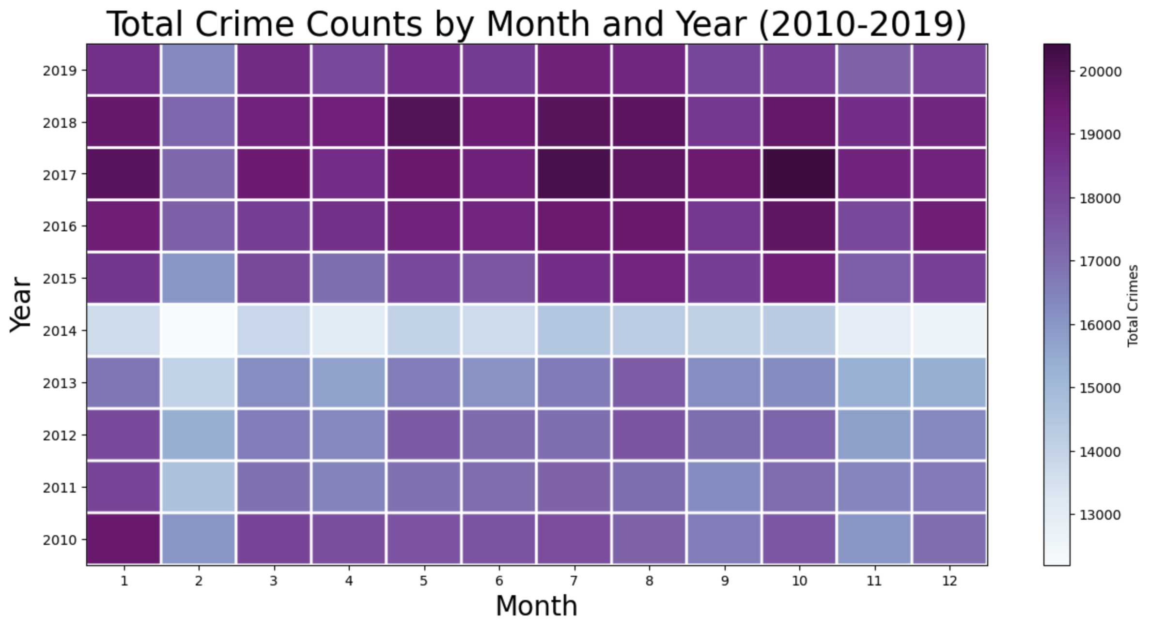
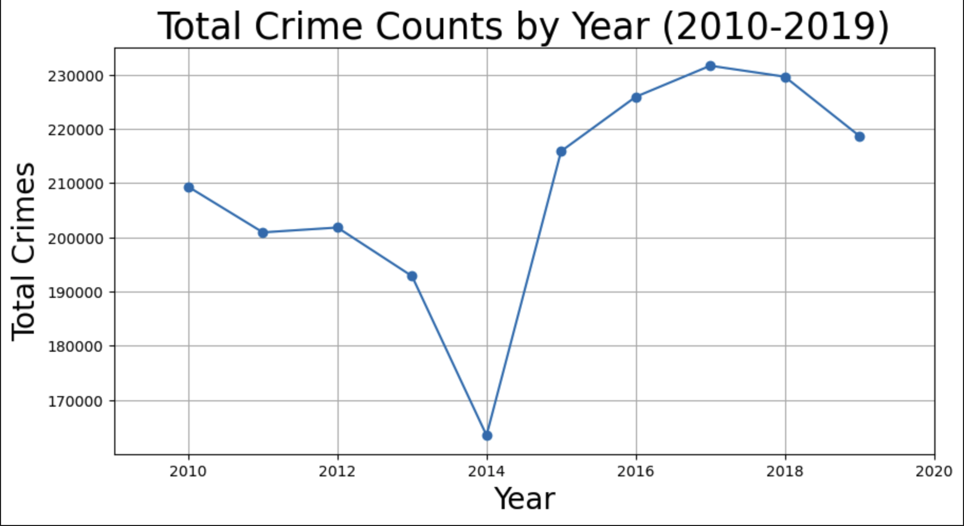
Analysis – Yearly trend
A drastic drop in 2014: 1) missing data 2) what happened in 2014?
Overall trend: decreased from 2010 to 2014, increased from 2014 to 2017, decreased from 2017 to 2019
Notes:
The left plot is a line chart of total crime counts by year. The right plot is a heatmap of total counts by month and year.
We can see from both chart that 1) theres a drastic drop in 2014, my guess for this drop is: 1)could this be kind of missing data? 2)if its not, then what happened in 2014 that leads to the drop.
Besides this, if we look through the overall trend, we can see the crime rate decresed from

Slide 5
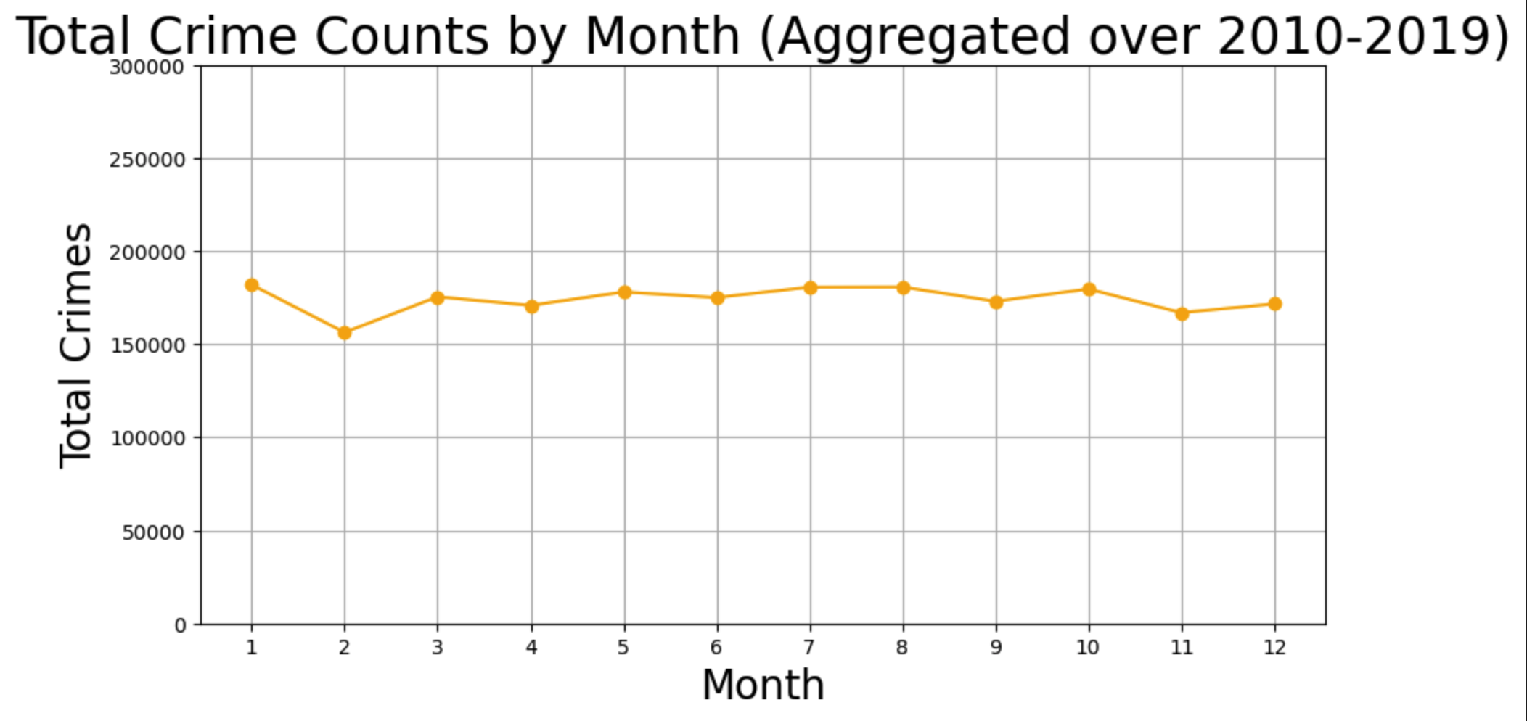
Analysis – Monthly trend
General consistency across months
Lowest crime rates: February
Highest crime rates: the summer months (June, July, August)
Notes:
For the monthly trend,
We can see there’s a genral consistency throughout months. But we do have the lowest crime rate in Feb, probably beacause it’s the shortest month in a year, and School in Session, less tourist activity due to cold weather
We have the highest crime rate in summer months. This could be due to a variety of factors such as weather, holidays, and social behavior patterns during these months.

Slide 6
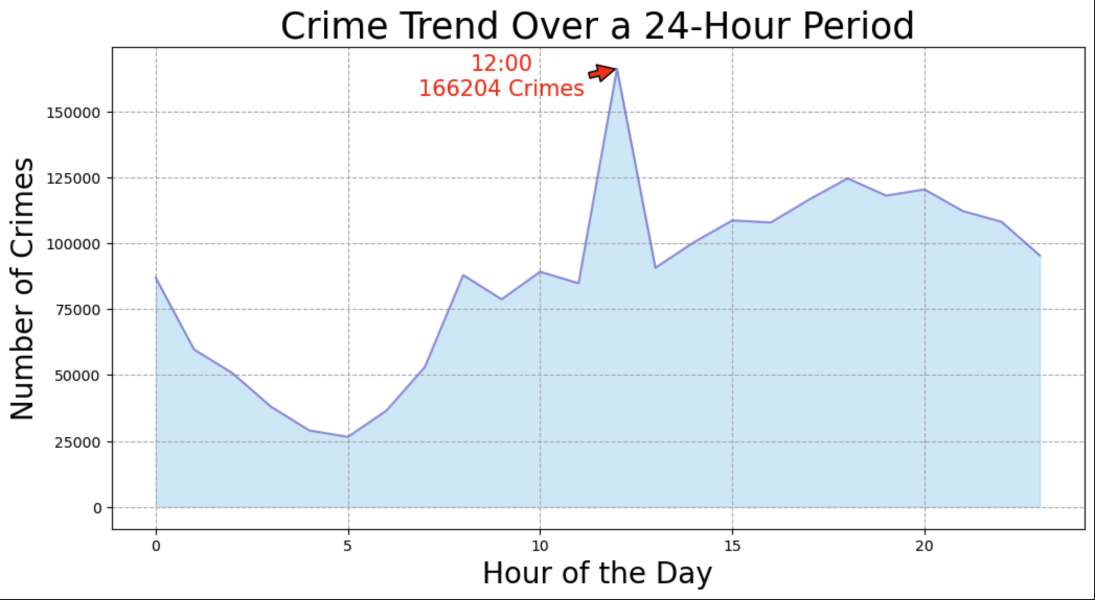
Analysis – Hourly trend
Less frequent in early hours in the morning.
Little upstick in late night.
Peak at 12:00 at noon.
Notes:
And next, if we Look throughout the whole day, we can see
increased pedestrian and vehicle traffic, as well as more active business operations, presenting more opportunities for certain types of crimes.

Slide 7
Analysis – crime map (2010-2019)
Fewer crimes: Beverly Hills, Landera Heights, San Fernando... (Higher Economic Status/Lower population densities/Better Law Enforcement/Community Programs…)
More crimes: downtown LA, Hollywood.. (Higher Population Density/Tourist Attractions/More Nightlife and Entertainment/More Homelessness/Economic Disparities…)
Notes:
For the geographic angle, it will be good to visualize the data by crime map. So here I generated a crime map iterates over 2010 to 2019.
As we can see, although there are changes in color overtime. There are some areas have continuous weaker color or darker color.

Slide 8
Key takeaways
The crime rate fluctuates up and down yearly,stays consistent generally monthly but do have the lowest in Feburary and highest during summer months.
There do exists a peak in crime incidents at a certain hour.
Some areas seems to have higher crime rates while other may have fewer, which could be due to factors like population density, economic activity, and urban infrastructure.
For citizens: identify high-risk areas and times for crime, allowing citizens to take precautions to enhance their personal safety.
For LAPD: The hourly crime trends could inform patrol scheduling, the monthly trends could influence community policing efforts during periods of anticipated higher crime rates, and a detailed crime map would be instrumental in resource allocation and urban planning.
The crime trends are complex and multifaceted, influenced by a myriad of factors including but not limited to socio-economic status, urban development, law enforcement, and temporal patterns. More analysis need to be conducted.

